Slide 1

POWER BI PROJECT
[E-Commerce Order and Delivery Tracker]
Summer Training — Power BI | [Chandigarh college of Enginnering]
Presented by
Course
Guided by
Date
[ISHANT] | [2419253]
[B.Tech — CSE]
[ms.Ashima]
[01-07-2026]

Slide 2
Agenda
01
Problem Statement & Objective
06
Dashboard Walkthrough
02
Dataset Overview
07
Key Insights & Findings
03
Data Model — Star Schema
08
Publishing to Power BI Service
04
Power Query — Cleaning Steps
09
Challenges & Learnings
05
DAX Measures
10
Conclusion & Q&A
2 / 14

Slide 3
01 Problem Statement
The dashboard centralizes order and delivery information, making it easier to track orders, identify delays, and improve operational efficiency and customer satisfaction
3 / 14

Slide 4
Problem Statement & Objectives
The Problem
Target User
Customers and administrators lacked a centralized system to track order status and delivery progress in real time. This caused delays in decision-making, increased customer inquiries, and reduced operational efficiency.
E-commerce administrators, warehouse managers, and customer support teams who needed a real-time view of order status, delivery progress, and customer information without manually tracking orders or updating Excel sheets.
Project Objectives
Connect & clean the raw dataset using Power Query
Design an interactive multi-page dashboard with 4+ visual types
Build a star schema data model with correct relationships
Publish the final report to Power BI Service
Create at least 5 meaningful DAX measures
4 / 14

Slide 5
02 Dataset Overview
E-commerce order management database and delivery tracking records
A structured dataset containing order, customer, payment, and shipment details
Order ID, Customer Name, Order Date, Product Name, Order Status, Payment Status, Shipment Date, Delivery Date, Delivery Partner, and Total Amount.
5 / 14

Slide 6
Dataset Overview
[ Excel]
[ 500]
[34]
[kaggle]
File Type
Rows
Columns
Source
Key Columns Used
Data Quality Steps (Power Query)
Column | Role in Dashboard
Order ID | Unique key per transaction
Order Date | Date dimension — time intelligence
Category | Product grouping for slicers
Sales | Revenue — base for SUM measures
Profit | Net profit — margin calculations
Payment Status Shipment Date | Indicates whether payment is completed Track dispatch timing
Removed duplicate rows
Fixed null values in [column]
Changed data types (Date, Number)
Renamed columns for clarity
Filtered out [cancelled/test] rows
6 / 14

Slide 7
03 Data Model
Fact Table: Orders
Dimension Tables: Customers, Products, Delivery, Payments, Date
Relationships:
Orders → Customers (Customer ID)
Orders → Products (Product ID)
Orders → Delivery (Delivery ID)
Orders → Payments (Payment ID)
Orders → Date (Order Date ID)
7 / 14

Slide 8
04 Dashboard Walkthrough
Overview Page: KPIs showing Total Orders, Delivered Orders, Pending Orders, and Revenue.
Order Tracking Page: Order status, shipment progress, and delivery timelines.
Delivery Analysis Page: Delivery performance by region and delivery partner.
Visuals: KPI Cards, Bar Charts, Pie Charts, Line Charts, Tables, and Slicers.
Interactivity: Filters for Date, Order Status, Product Category, Delivery Partner, and Region with drill-down and cross-filtering capabilities.
11 / 14

Slide 9
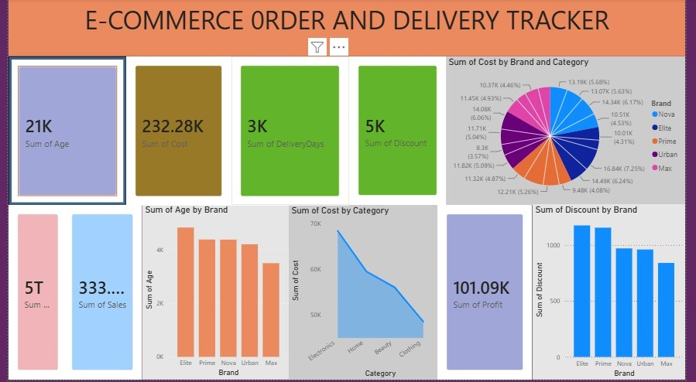
Dashboard — Page 1: Overview
Visuals on this page
KPI Cards — Total Age, Total Sales,
Total Profit, Delivered Orders
Column Chart — Sum of Age by Brand,
Sum of Discount by Brand
Area Chart — Sum of cost by category
[ Screenshot — Overview Page ]
Pie Chart — sum of cost by Brand and category
This page provides a quick overview of the overall order and delivery performance, including total orders, sales, discounts, and delivered orders. It helps users monitor key business metrics and identify trends or issues at a glance
Key Insight
12 / 14

Slide 10
Key Findings & Insights
Elite contributes the highest total cost among all brands, making it the largest revenue-driving brand in the dataset.
(Supported by the Pie Chart: Sum of Cost by Brand and Category.)
Elite brand provides the highest total discount, whereas Urban offers the lowest discount among all brands.
(Supported by the Bar Chart: Sum of Discount by Brand.)
01
04
Elite and Prime brands have the highest total age values, while Max records comparatively lower age values.
(Supported by the Column Chart: Sum of Age by Brand.)
.
The dashboard records strong overall business performance with approximately 333K sales, 232K cost, and 101K profit while maintaining 3K delivery days and 5K total discount distribution.
(Supported by the KPI Cards.)
02
05
Electronics category contributes the highest cost, followed by Fashion and Home products, indicating stronger customer demand in these categories.
(Supported by the Area Chart: Sum of Cost by Category.)
.
03
13 / 14

Slide 11
Conclusion & Thank You
Created a Power BI dashboard to track e-commerce orders, deliveries, sales, and customer details.
The dashboard improved order visibility and helped monitor sales and delivery performance more effectively
Used Power Query to clean and organize the data before creating the dashboard.
Future Scope: Add real-time tracking and smarter insights to make order management faster and more efficient.
Questions & Feedback Welcome
14 / 14

